Slide 1
Web content Mining
Supervised Learning

Slide 2
Road Map
Basic concepts
Naïve Bayesian classification
Naïve Bayes for text classification
Decision tree induction
Evaluation of classifiers
Ensemble methods: Bagging and Boosting
Summary

Slide 3
An example application
An emergency room in a hospital measures 17 variables (e.g., blood pressure, age, etc) of newly admitted patients.
A decision is needed: whether to put a new patient in an intensive-care unit.
Due to the high cost of ICU, those patients who may survive less than a month are given higher priority.
Problem: to predict high-risk patients and discriminate them from low-risk patients.

Slide 4
Another application
A credit card company receives thousands of applications for new cards. Each application contains information about an applicant,
age
Marital status
annual salary
outstanding debts
credit rating
etc.
Problem: to decide whether an application should approved, or to classify applications into two categories, approved and not approved.

Slide 5
Machine learning and our focus
Like human learning from past experiences.
A computer does not have “experiences”.
A computer system learns from data, which represent some “past experiences” of an application domain.
Our focus: learn a target function that can be used to predict the values of a discrete class attribute, e.g., approve or not-approved, and high-risk or low risk.
The task is commonly called: Supervised learning, classification, or inductive learning.

Slide 6
The data and the goal
Data: A set of data records (also called examples, instances or cases) described by
k attributes: A₁, A₂, … A_{k}.
a class: Each example is labelled with a pre-defined class.
Goal: To learn a classification model from the data that can be used to predict the classes of new (future, or test) cases/instances.
Notes:
Induction is different from deduction and DBMS does not not support induction;
The result of induction is higher-level information or knowledge: general statements about data
There are many approaches. Refer to the lecture notes for CS3244 available at the Co-Op.
We focus on three approaches here, other examples:
Other approaches
Instance-based learning
other neural networks
Concept learning (Version space, Focus, Aq11, …)
Genetic algorithms
Reinforcement learning

Slide 7
WEB PAGE CLASSIFICATION

Slide 8

Naive Bayes Text Classifier

Slide 9
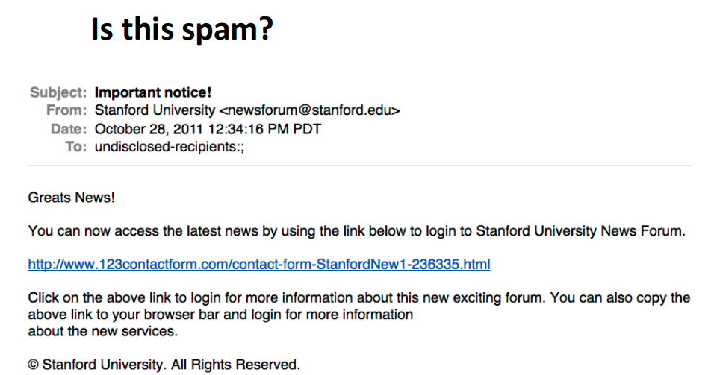

Slide 10
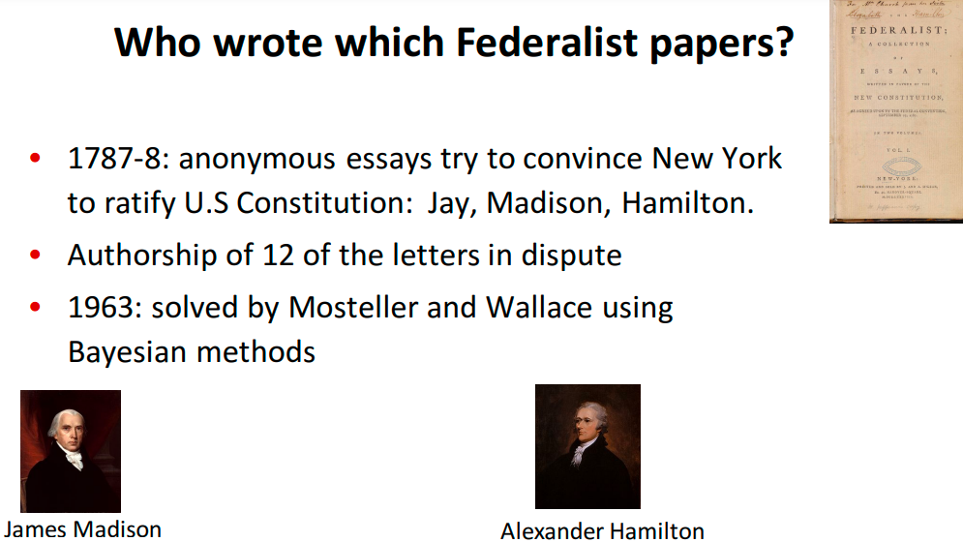

Slide 11
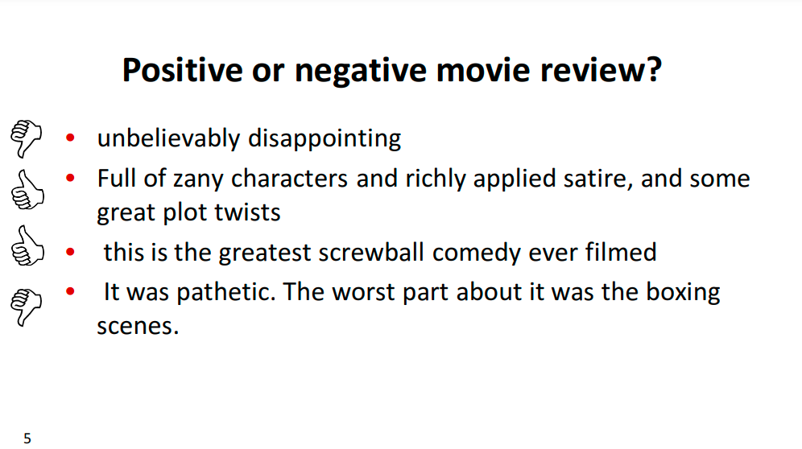

Slide 12

Customer Review

Slide 13
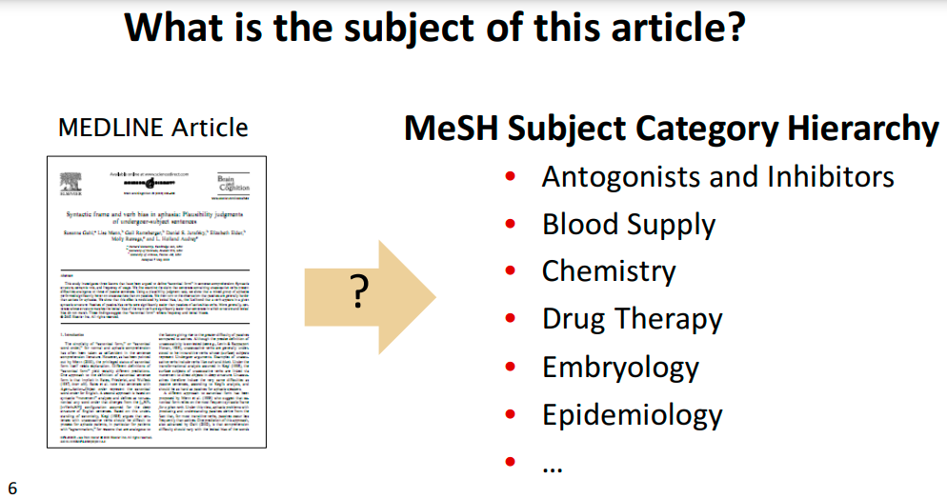

Slide 14
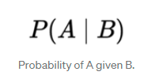
Naive Bayes rule
From elementary probability, what is the probability of an event A happening given that another event B has also happened? In order words, what’s the probability of A given B?

Slide 15
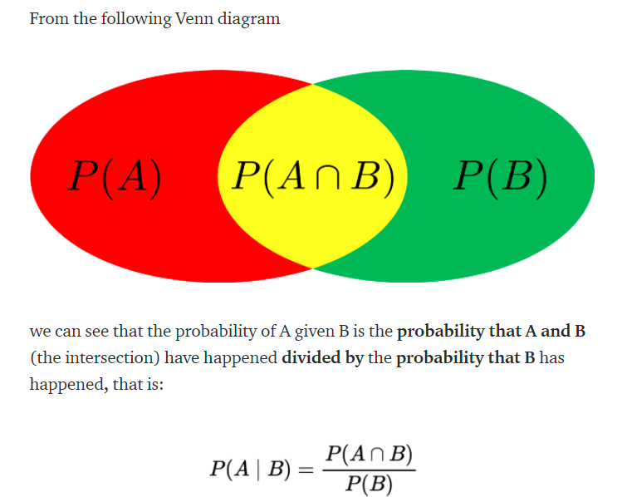

Slide 16
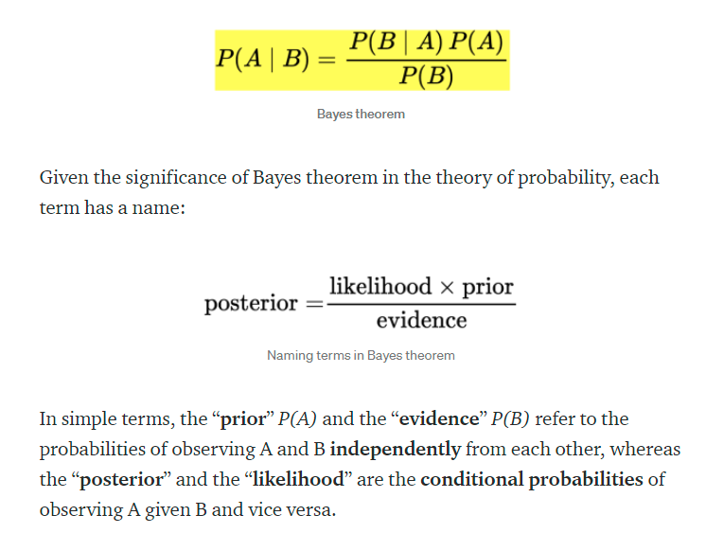

Slide 17
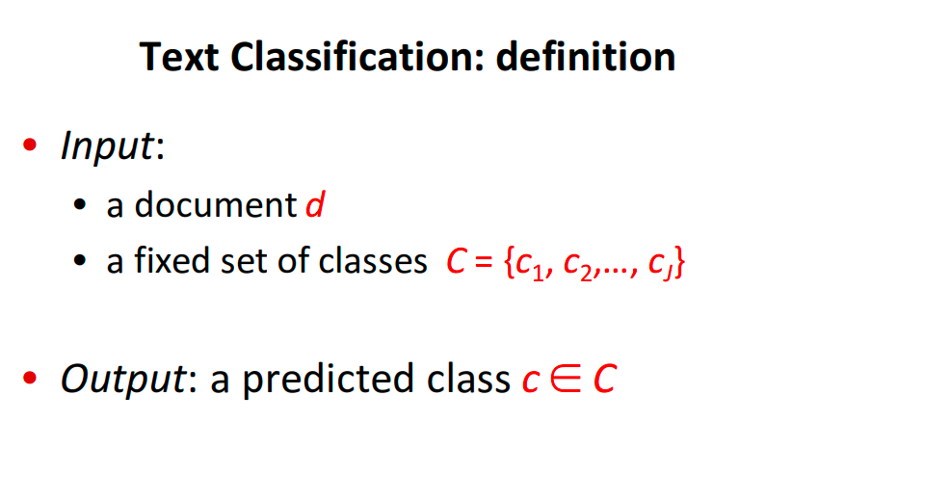

Slide 18
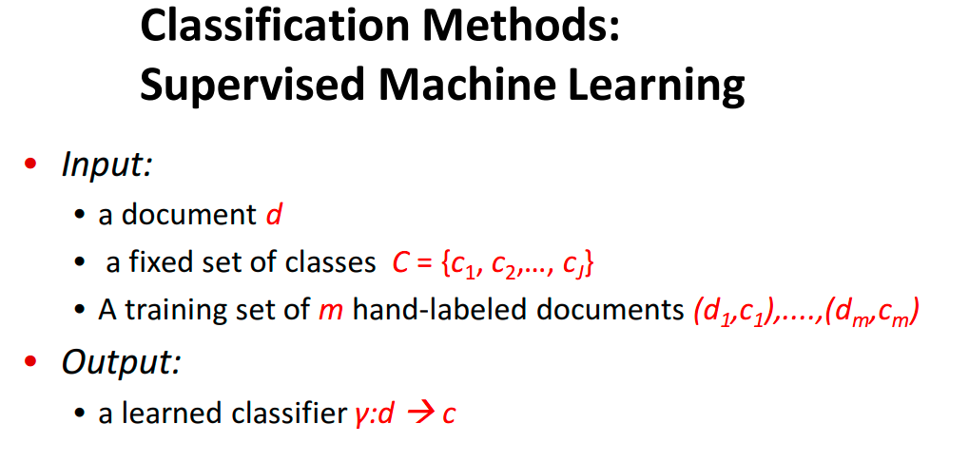

Slide 19
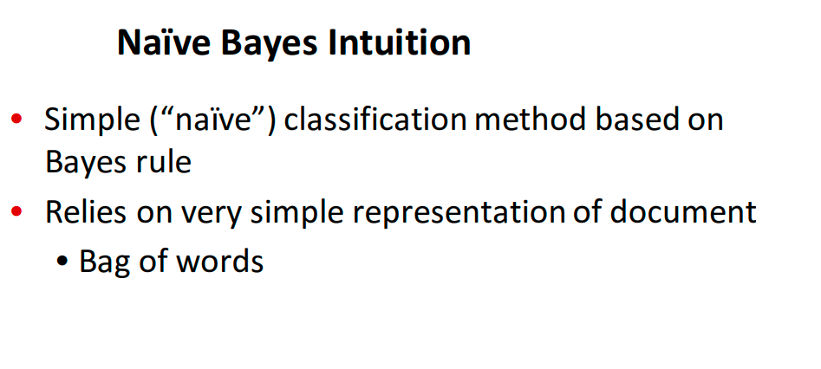

Slide 20
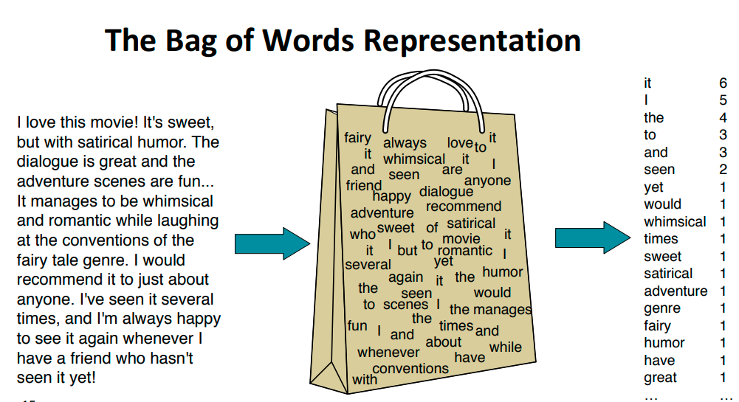

Slide 21
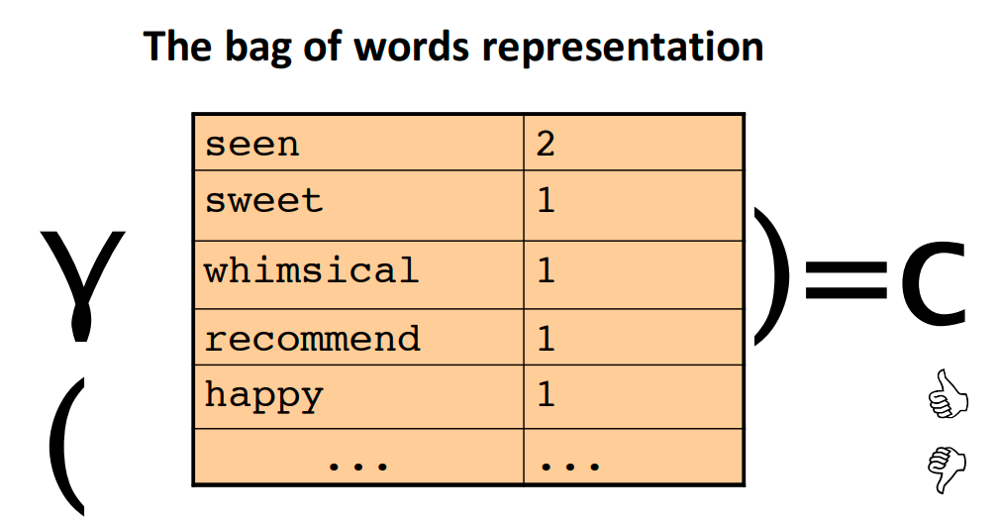

Slide 22
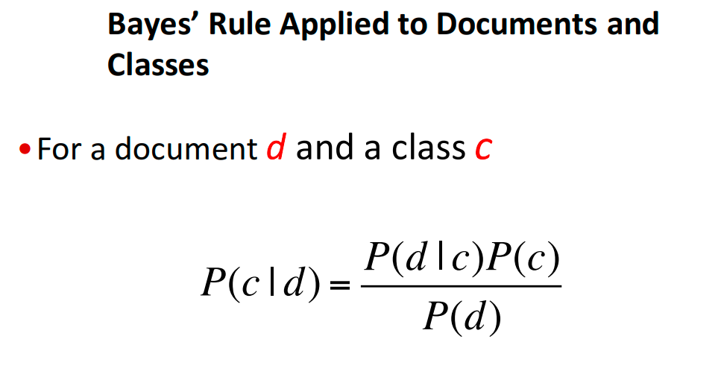

Slide 23
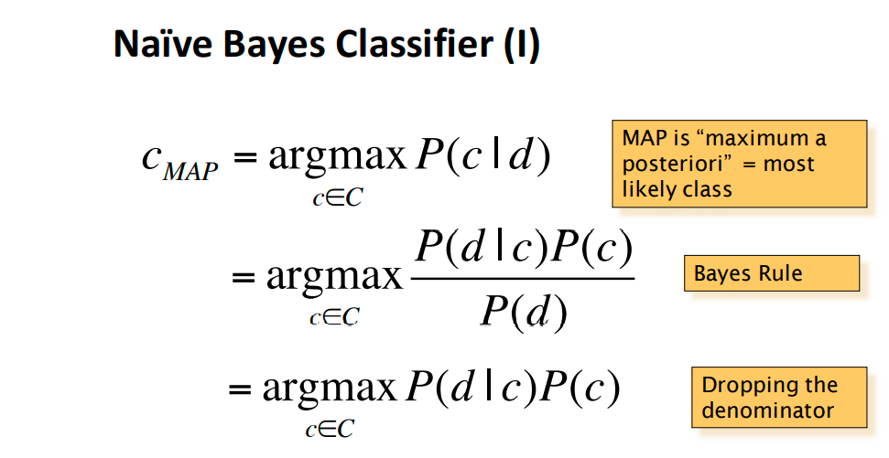

Slide 24
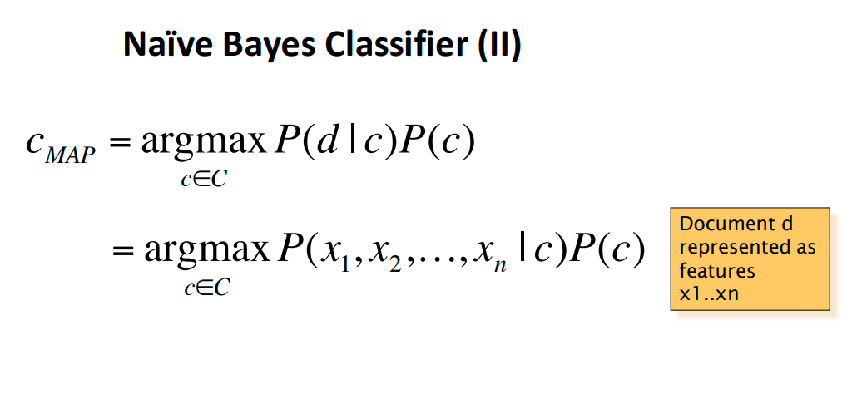

Slide 25
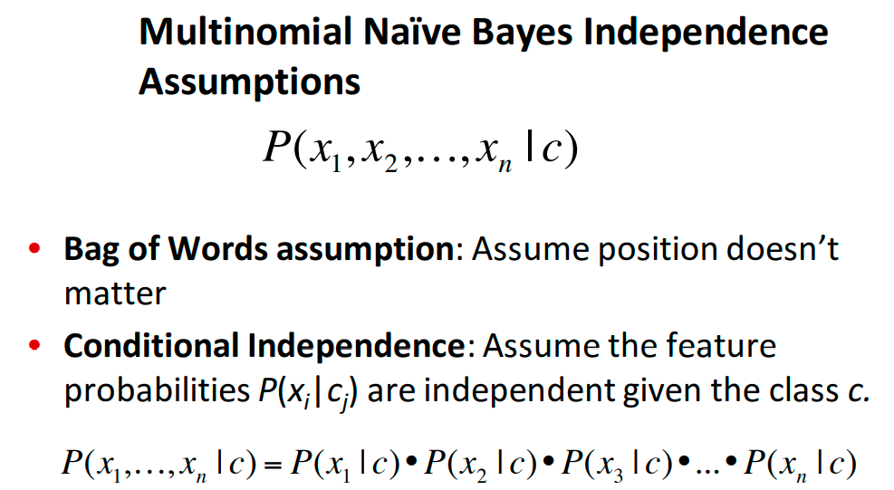

Slide 26
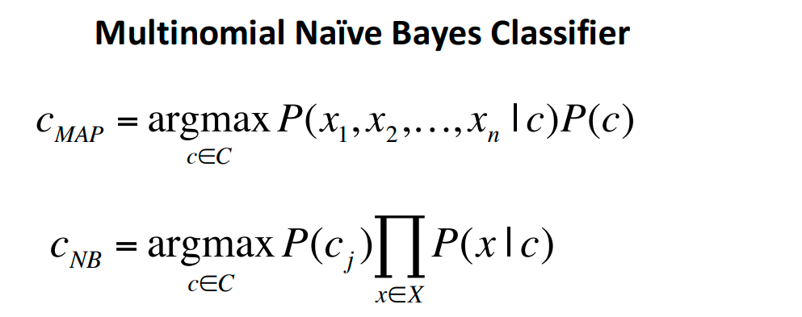

Slide 27
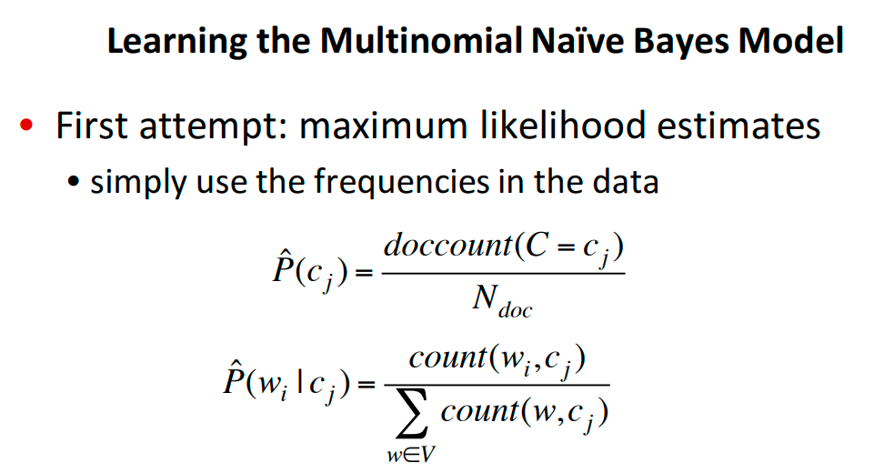

Slide 28
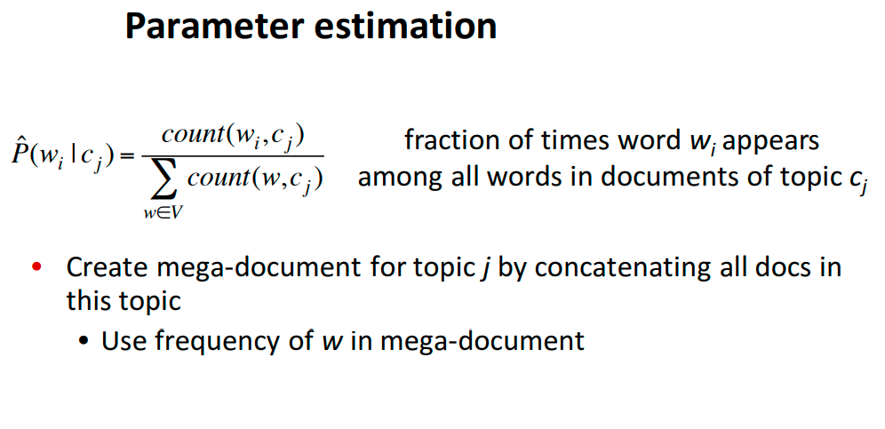

Slide 29
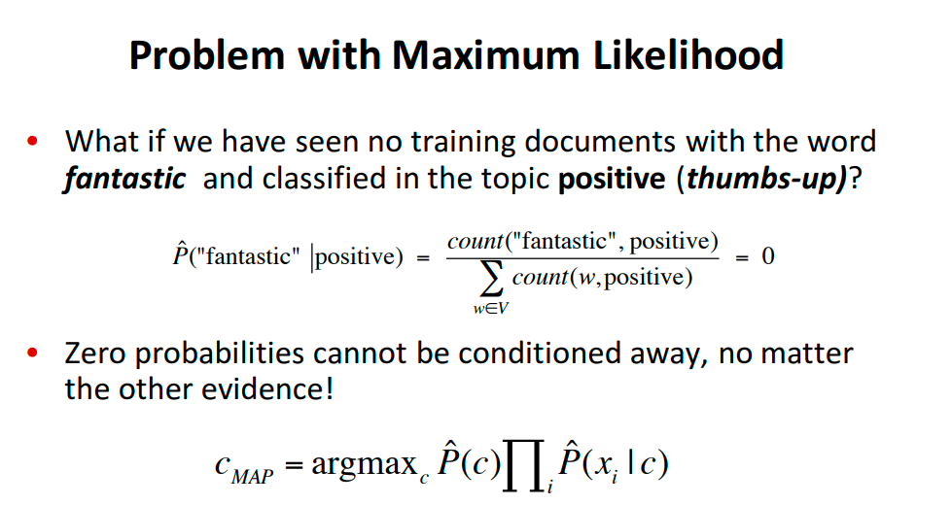

Slide 30
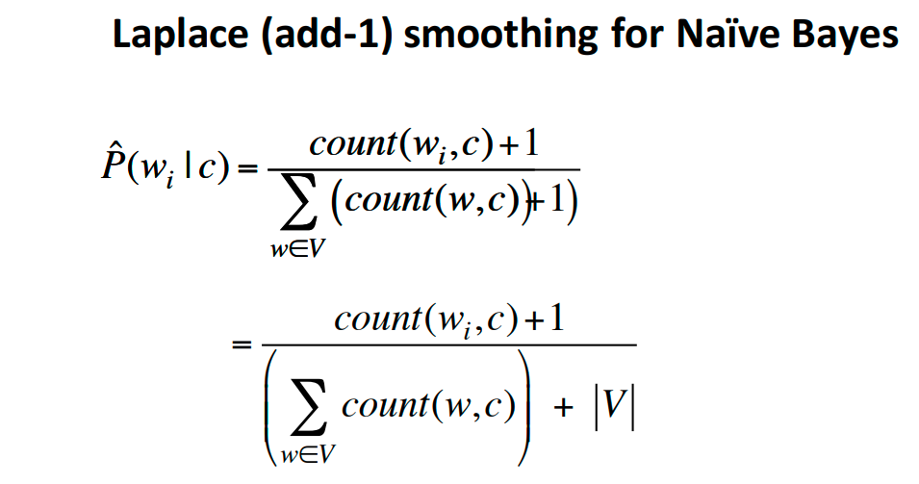

Slide 31
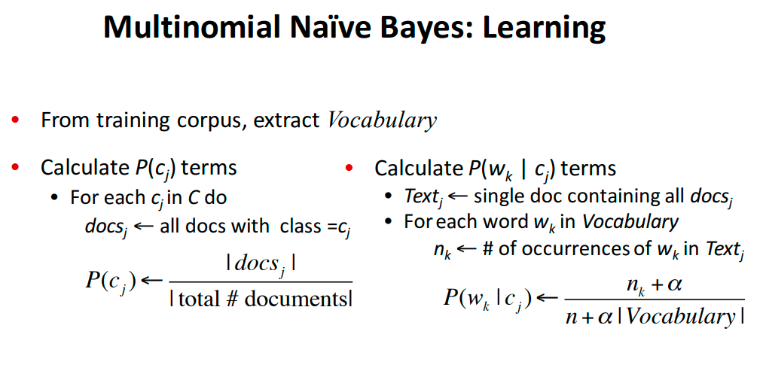

Slide 32
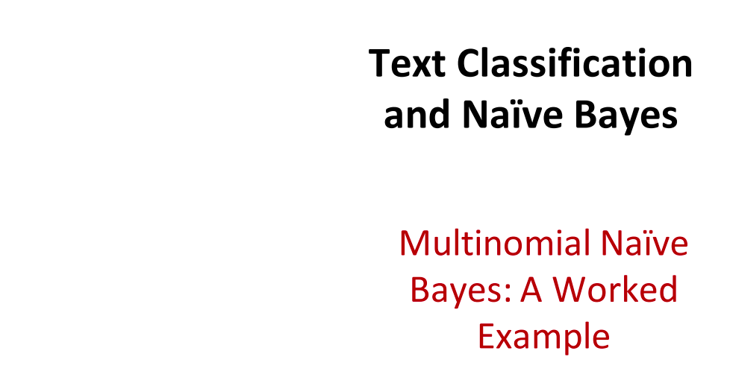

Slide 33
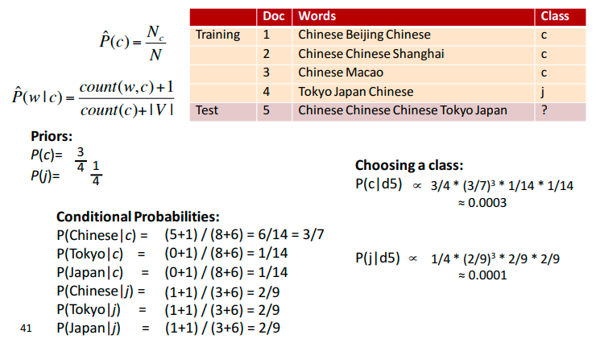

Slide 34
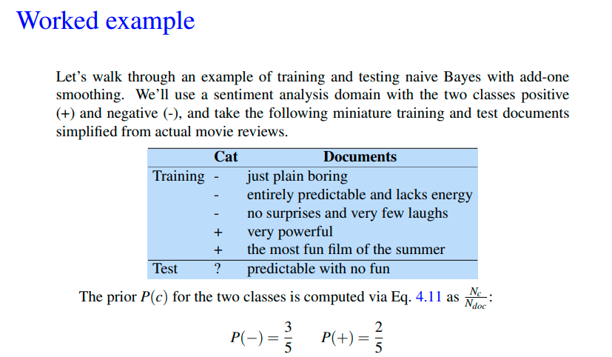

Slide 35
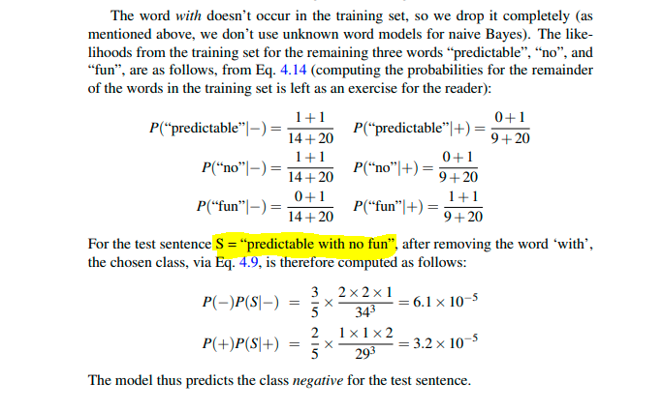

Slide 36
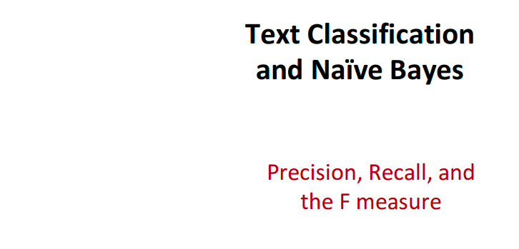

Slide 37
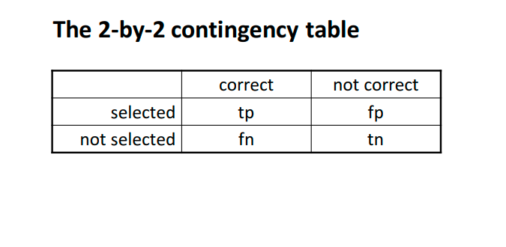

Slide 38
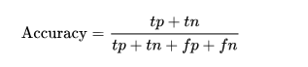
Accuracy of this model would be the number of correct spams marked out of the test set emails.

Slide 39
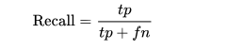
Recall = spams correctly identified / (spams correctly identified + spams incorrectly identified as ham)

Slide 40
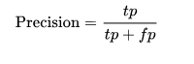
Precision: Gives us the ratio of cases where the number of spam classifications by the model to the actual number of spams in the data.

Slide 41
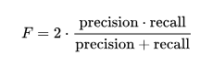
F- score is the harmonic mean of recall and precision.

Slide 42
Implementing a Naive Bayes classifier for text categorization

Slide 43
Naive Bayes is a learning algorithm commonly applied to text classification.
Some of the applications of the Naive Bayes classifier are:
(Automatic) Classification of emails in folders, so incoming email messages go into folders such as: “Family”, “Friends”, “Updates”, “Promotions”, etc.
(Automatic) Tagging of job listings. Given a job listing in raw text format, we can assign it tags such as: “software development”, “design”, “marketing”, etc.
(Automatic) Categorization of products. Given a product description, we can assign it into categories such as: “Books”, “Electronics”, “Clothing”, etc.

Slide 44
Step 1. Identify the prerequisites to train a Naive Bayes classifier
The only prerequisite is to have an existing set of examples for each category (class) that we wish to bucket/categorize pieces of text into.
For instance, for the job listings classification example, we need a set of job listings that are known for a fact to be targeted (i.e. labeled) for “software developers”, a set of job listings known to be targeted for “designers”, and a set of job listings targeted for “marketers”.
In this case, there are three classes (“software development”, “design”, and “marketing”). With samples of job listings in each category, we can train a Naive Bayes classifier so that new job listings are automatically categorized.

Slide 45
Spam/Ham classification
The example that we will explore for the remaining of this article is Spam/Ham classification, therefore, there are two classes: “Spam” and “Ham” (i.e. non-spam). As mentioned before, the only prerequisite is to have an existing training set of e-mails known to be Spam and a training set of emails known to be Ham.

Slide 46
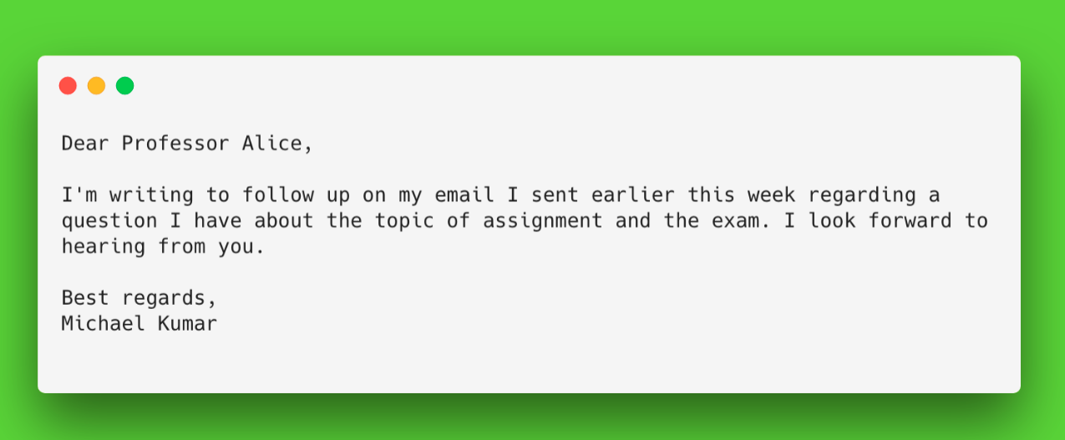
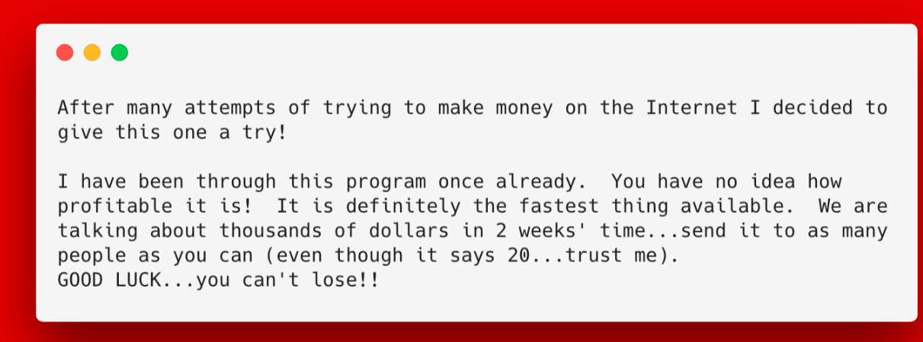

Slide 47
Step 2. Computing the Term-Document Matrix (TDM) for each class
A term-document matrix (TDM) consists of a list of word frequencies appearing in a set of documents.
The TDM matrix is a sparse rectangular matrix of n words and m documents. And it’s said to be sparse because it contains mostly zeros. The entry (i,j) of the TDM matrix represents the frequency of word “i” in document “j”.

Slide 48
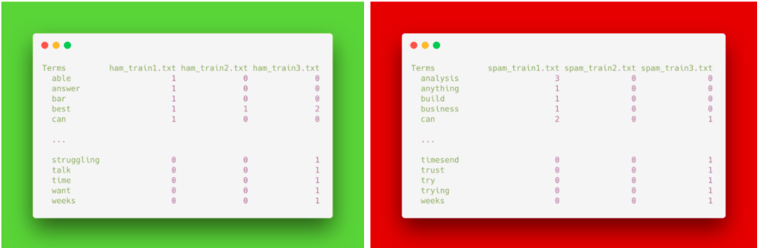
Term document matrix excerpts for the HAM and SPAM emails.

Slide 49
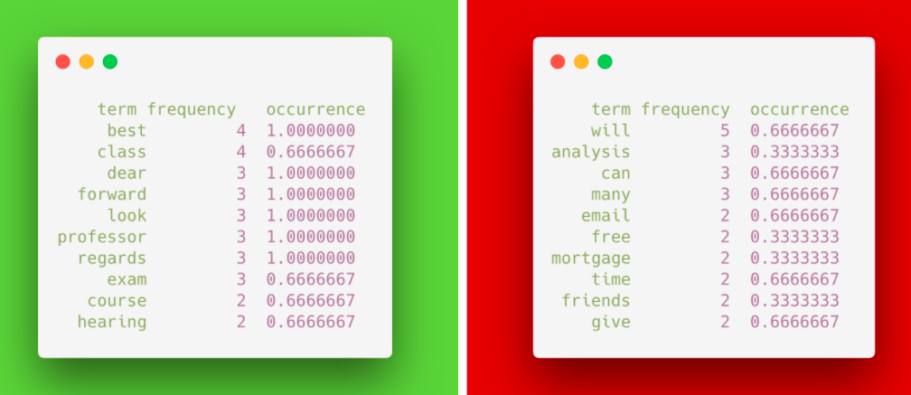
Sept 3. Compute frequencies
Once the TDM matrices are computed for each class, the next step is to compute the frequency and occurrence of each term:

Slide 50
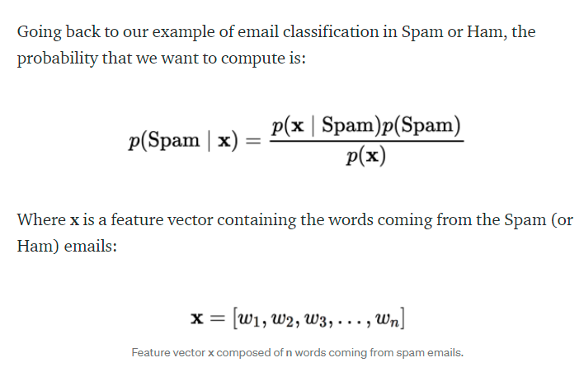
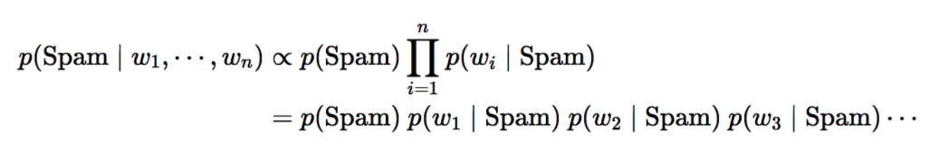
Step 4. Recall the Naive Bayes rule

Slide 51
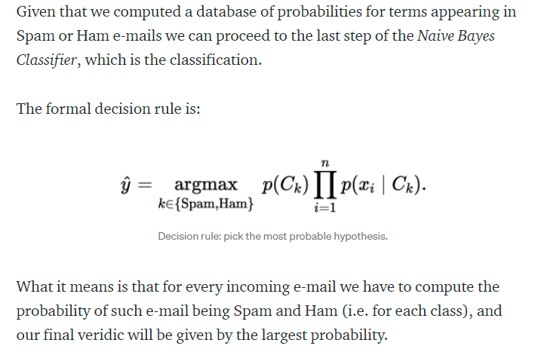
Step 5. Compute the probability of an incoming email being Spam or Ham

Slide 52
Problem
Imagine we’re given a training set of 5000 randomly chosen emails. We examine them and label 2000 of them as spam emails and 3000 as ham emails (so P(S) = 0.4, and P(H) = 0.6).
We’d like to calculate P(“ Lottery” | S) and P(“ Lottery” | H). The easiest thing to do would be to count how many spam emails have “ Lottery” and divide that by the total number of spam emails, and do the same thing for ham. So, if there were 216 spam emails with “ Lottery” and 12 ham emails with “ Lottery”, we’d say

Slide 53
P(“Lottery” | S) = 216 /2000 ≈ 11%
P(“Lottery” | H) = 12 / 3000 ≈ 0.40%

Slide 54
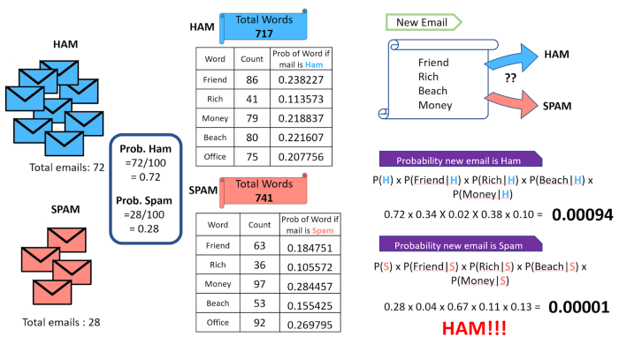

Slide 55
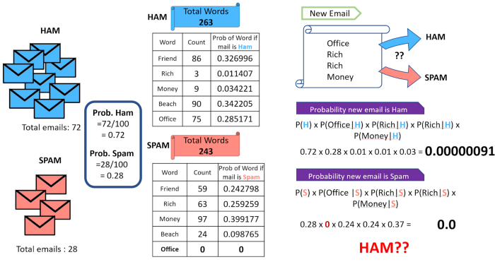

Slide 56
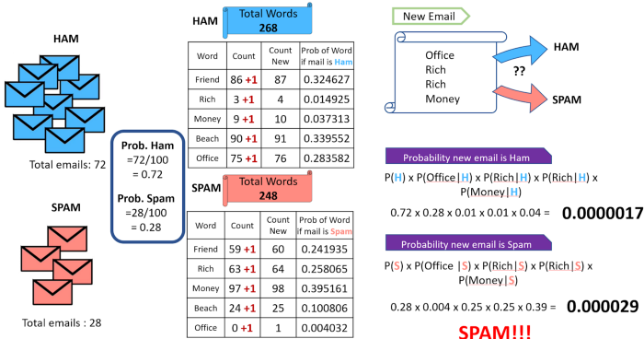

Slide 58
Decision Tree Algorithm A Classification Technique
Dr. A. Bhuvaneswari

Slide 59
Outline
Introduction
Example
Principles
Entropy
Information gain
Evaluations
Demo

Slide 60
An example application
An emergency room in a hospital measures 17 variables (e.g., blood pressure, age, etc) of newly admitted patients.
A decision is needed: whether to put a new patient in an intensive-care unit.
Due to the high cost of ICU, those patients who may survive less than a month are given higher priority.
Problem: to predict high-risk patients and discriminate them from low-risk patients.

Slide 61
Another application
A credit card company receives thousands of applications for new cards. Each application contains information about an applicant,
age
Marital status
annual salary
outstanding debts
credit rating
etc.
Problem: to decide whether an application should approved, or to classify applications into two categories, approved and not approved.

Slide 62
Machine learning and our focus
Like human learning from past experiences.
A computer does not have “experiences”.
A computer system learns from data, which represent some “past experiences” of an application domain.
Our focus: learn a target function that can be used to predict the values of a discrete class attribute, e.g., approve or not-approved, and high-risk or low risk.
The task is commonly called: Supervised learning, classification, or inductive learning.

Slide 63
The data and the goal
Data: A set of data records (also called examples, instances or cases) described by
k attributes: A₁, A₂, … A_{k}.
a class: Each example is labelled with a pre-defined class.
Goal: To learn a classification model from the data that can be used to predict the classes of new (future, or test) cases/instances.
Notes:
Induction is different from deduction and DBMS does not not support induction;
The result of induction is higher-level information or knowledge: general statements about data
There are many approaches. Refer to the lecture notes for CS3244 available at the Co-Op.
We focus on three approaches here, other examples:
Other approaches
Instance-based learning
other neural networks
Concept learning (Version space, Focus, Aq11, …)
Genetic algorithms
Reinforcement learning

Slide 64
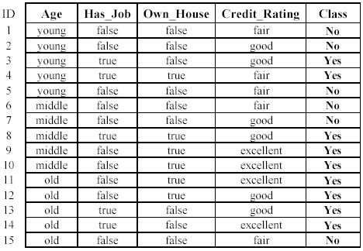
An example: data (loan application)
Approved or not

Slide 65
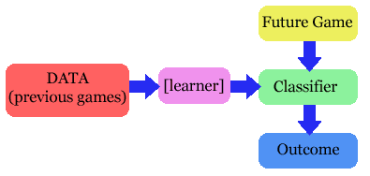
The problem
Given a set of training cases/objects and their attribute values, try to determine the target attribute value of new examples.
Classification
Prediction

Slide 66
Why decision tree?
Decision trees are powerful and popular tools for classification and prediction.
Decision trees represent rules, which can be understood by humans and used in knowledge system such as database.

Slide 67
key requirements
Attribute-value description: object or case must be expressible in terms of a fixed collection of properties or attributes (e.g., hot, mild, cold).
Predefined classes (target values): the target function has discrete output values (bollean or multiclass)
Sufficient data: enough training cases should be provided to learn the model.

Slide 68
A simple example
You want to guess the outcome of next week's game between the MallRats and the Chinooks.
Available knowledge / Attribute
was the game at Home or Away
was the starting time 5pm, 7pm or 9pm.
Did Joe play center, or forward.
whether that opponent's center was tall or not.
…..

Slide 69
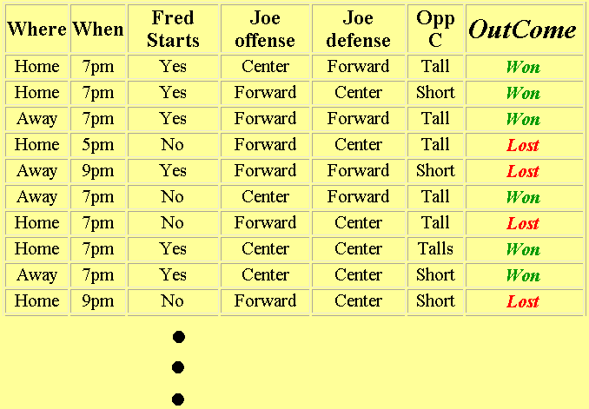
Basket ball data

Slide 70
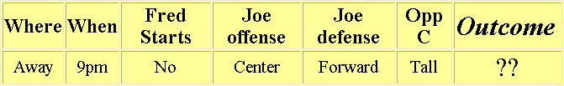
What we know
The game will be away, at 9pm, and that Joe will play center on offense…
A classification problem
Generalizing the learned rule to new examples

Slide 71
Definition
Decision tree is a classifier in the form of a tree structure
Decision node: specifies a test on a single attribute
Leaf node: indicates the value of the target attribute
Arc/edge: split of one attribute
Path: a disjunction of test to make the final decision
Decision trees classify instances or examples by starting at the root of the tree and moving through it until a leaf node.

Slide 72
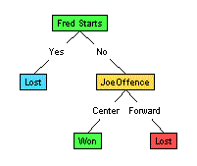
Illustration
(1) Which to start? (root)
(2) Which node to proceed?
(3) When to stop/ come to conclusion?

Slide 73
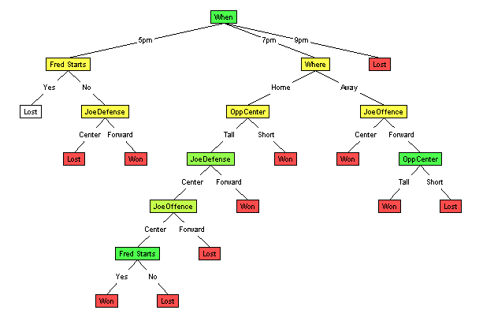
Random split
The tree can grow huge
These trees are hard to understand.
Larger trees are typically less accurate than smaller trees.

Slide 75
Principled Criterion
Selection of an attribute to test at each node - choosing the most useful attribute for classifying examples.
information gain
measures how well a given attribute separates the training examples according to their target classification
This measure is used to select among the candidate attributes at each step while growing the tree

Slide 76
Entropy
A measure of homogeneity of the set of examples.
Given a set S of positive and negative examples of some target concept (a 2-class problem), the entropy of set S relative to this binary classification is
E(S) = - p(P)log2 p(P) – p(N)log2 p(N)

Slide 77
Suppose S has 25 examples, 15 positive and 10 negatives [15+, 10-]. Then the entropy of S relative to this classification is
E(S)=-(15/25) log2(15/25) - (10/25) log2 (10/25)

Slide 78
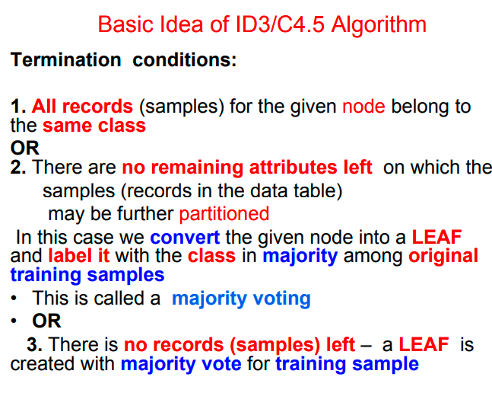

Slide 79
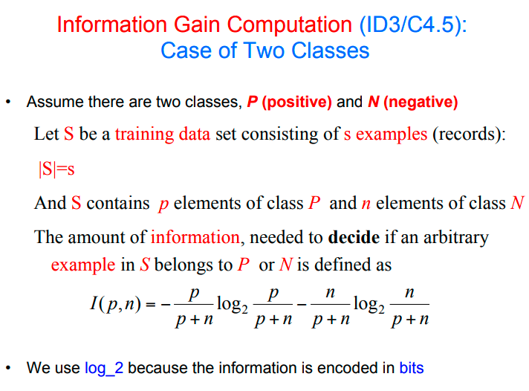

Slide 80


Slide 81


Slide 82


Slide 83


Slide 84
Steps Involved
Compute Entropy of class
Compute Entropy of each attribute
Compute Information Gain
Make the Max. Information Gain attribute as root node

Slide 85

Decision Tree Steps

Slide 86



Slide 87


Slide 88


Slide 89


Slide 90


Slide 91
Steps Involved
Compute Entropy of class
Compute Entropy of each attribute
Compute Information Gain
Make the Max. Information Gain attribute as root node

Slide 92


Slide 93


Slide 94


Slide 95


Slide 96


Slide 97


Slide 98


Slide 99


Slide 100


Slide 101


Slide 102


